Slide 1
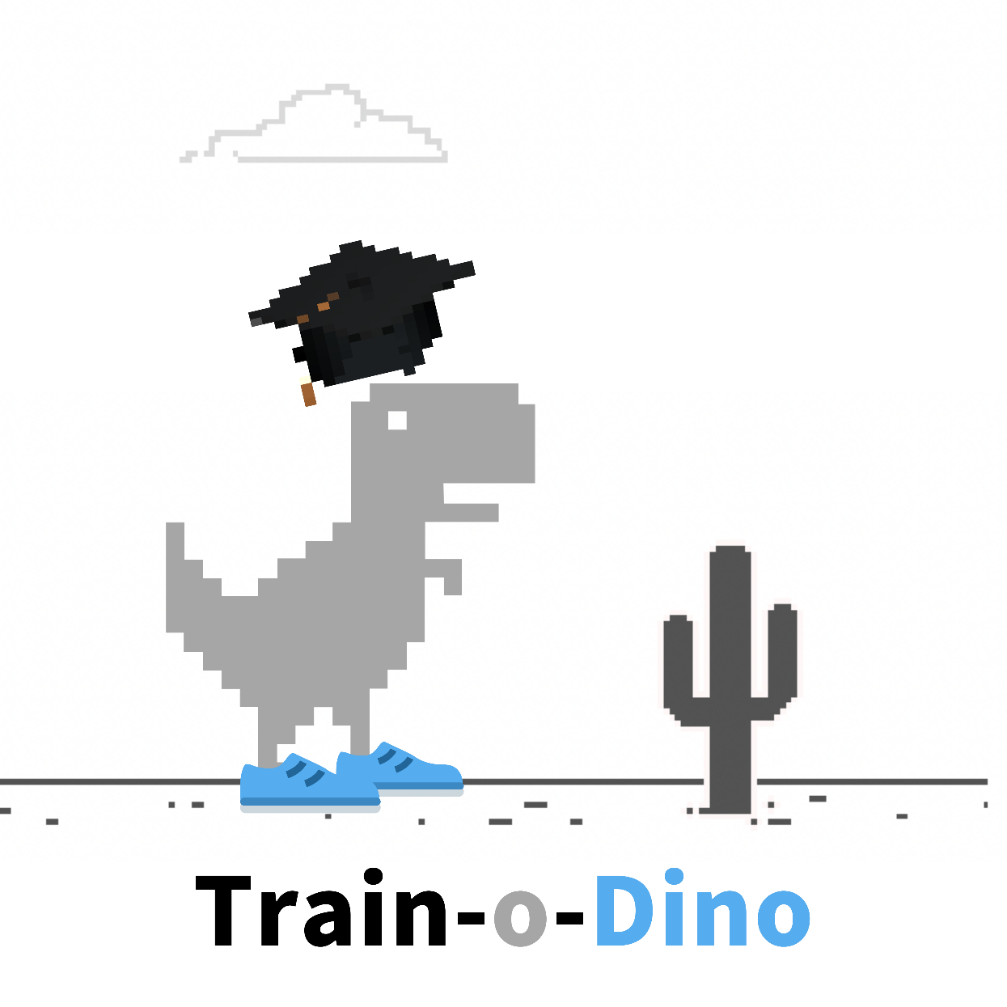
Project Presentation
Arunpriya Gobinath || 100841238
Jugnu Shefin || 100814025
Ramasubramanian Dharumaperumal || 100810343
Raj Dholakia || 100813041
Sourabh Potdar || 100844478
Product Manager: Marcos Bittencourt

Slide 2
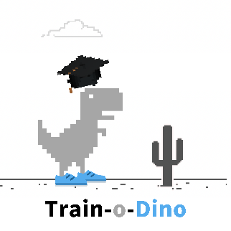
Table of Contents
Problem Description
Project demo
Technologies
Challenges
Solution Description
This Photo by Unknown Author is licensed under CC BY-NC

Slide 3
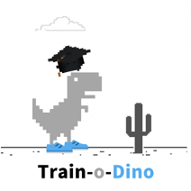
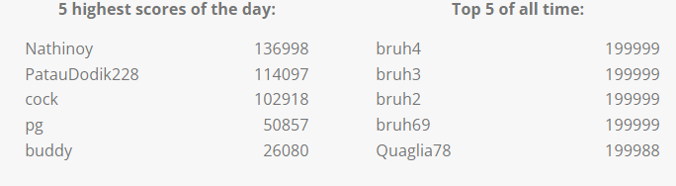
Problem Description
What is the Dino Run game?
When our internet connection goes down and we feel like a Neanderthal, Google understands our plight and provides some fun entertainment to pass the time while our connection to the World Wide Web is resurrecting Chrome dinosaur offline game!
It is a primitive endless runner game in the Chrome browser. The protagonist is a charming little T-Rex dinosaur who is running through an ancient desert.
What is the goal of the Game?
Of course, the dinosaur game has its purpose: to avoid cacti and pterodactyls. Though the game seems easy, it does not take long to get hard because the game’s speed will be constantly increasing as our progress further
How to play the game?
On both desktop and mobile, the game may be played in the Chrome browser. The control is the simplest: When the black dinosaur appears in our browser, suggesting that there is no Internet connection, we just hit the spacebar to begin the game. Jumping over obstacles is also done with the spacebar. To duck, use the down arrow. If we're on a mobile device, simply tapping the little Chrome Dino will activate it and help it avoid obstacles.
Why should we train this Dino?
If we are trying to create AI, why not try to see how these algorithms perform at playing games? Games can be learnt from scratch – with usually a simple goal (of survival in this case).
Training a virtual agent to outperform human players can teach us how to optimize different processes in a variety of different and exciting subfields. By better understanding different aspects of intelligence, we can use this knowledge as inspiration to build novel computer systems that learn to find solutions to difficult problems on their own.
What are the high scores like?
Source : (https://chromedino.com/)

Slide 4
Solution Description
Showcase the capabilities of a reinforcement learning algorithm using the Chrome Dino Game.
Control the obstacles being given to the Dino Agent.
Algorithm
Q-Learning Reinforcement learning algorithm.
Model trained for 4000 epochs has a highest score of over 2000 in the game.
A set of 4 images (frames) is analyzed by the model to determine
Pre-processed images are used by the model to take an action: FORWARD, JUMP, DUCK.
Dino Game
Modify Chrome Dino Game’s original code to control the obstacles.
Add small cacti, large cacti and Pterodactyl (obstacles in the game) using buttons.
Deploy two versions of the game using Microsoft’s Azure cloud services.

Slide 5


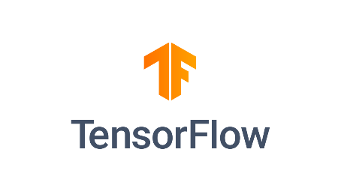


Technologies to be Used
Python
Machine learning libraries : Scikit-learn, TensorFlow, Keras
HTML/CSS/JavaScript for building the browser extension
Selenium
Git and GitHub for code management and version control.

Slide 6
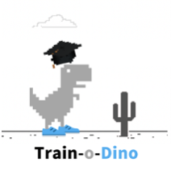
Challenges The most difficult problems faced during implementation.
Controlling the obstacles.
Integrating the game (JavaScript) and machine learning algorithm (Python).
Deploying the system – integration issues.

Slide 7
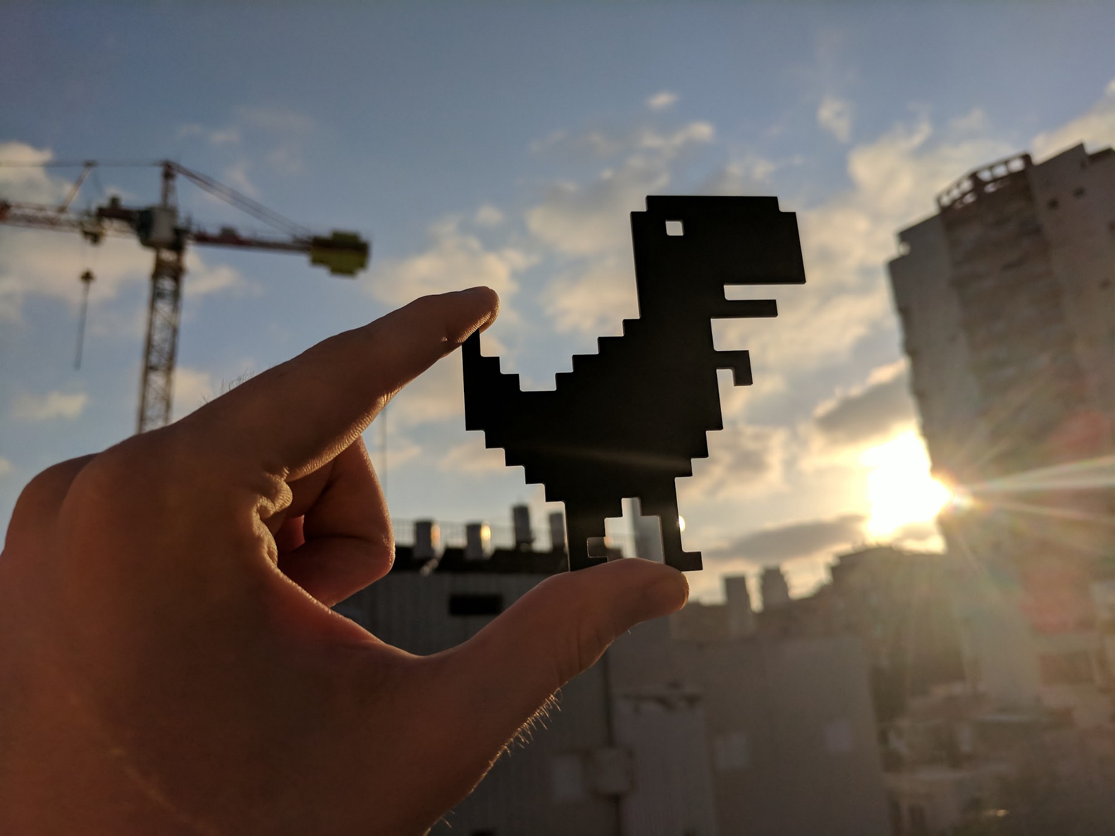
Demo Time!
This Photo by Unknown Author is licensed under CC BY-NC-ND
This Photo by Unknown Author is licensed under CC BY-SA

Slide 8

Thank you!

